Slide 1
NodeJS Fundamental (session 2)
Tran Minh

Slide 2
Agenda
Understanding module.exports and exports
Why do we need Modules?
Different Module Format
Forms, File Uploads and Security with Node.js and Express
Create form with validate function
Security
File Uploads
Q&A

Slide 3
module.exports - exports

Slide 4
module.exports and exports
Focus Items
Why do we need modules
Different module formats
Requiring a Module
Creating and Exporting a Module
Exporting a Default Value
What’s the difference between module.exports and exports?

Slide 5
Why do we need Modules?
Technically we can write code without modules.
In JavaScript, modules should ideally allow us to
Abstract code: to delegate functionality to specialized libraries so that we don’t have to understand the complexity of their actual implementation.
Encapsulate code: to hide code inside the module if we don’t want the code to be changed.
Reuse code: to avoid writing the same code repeatedly.
Manage dependencies: to easily change dependencies without rewriting our code

Slide 6
Different Module Format
As JavaScript originally had no concept of modules, a variety of competing formats have emerged over time
The Asynchronous Module Definition (AMD) format is used in browsers.
The CommonJS (CJS) format is used in Node.js
The ES Module (ESM) format. Such as ES6 (ES2015), Javascript supports a native module format.
The System.register format was designed to support ES6 modules within ES5.
The Universal Module Definition (UMD) format can be used both in the browser and in Node.js.

Slide 7
Different Module Format
Module patterns in ES5
EcmaScript 5 and earlier editions were not designed with modules in mind
Over time, developers produced different patterns to simulate modular design in JavaScript

Slide 8
Immediately Invoked Function Expressions (IIFE)
IIFE is an anonymous function that is invoked when it is declared
The function is surrounded by parentheses
Immediately invoking a function declaration throws an error:
// Function expression (function(){ console.log('test'); })()
// Immediately Invoked Function Declaration function(){ console.log('test'); }() // => Uncaught SyntaxError: Unexpected token )

Slide 9
IIFE (2)
Immediately Invoked Function Expressions allow us to:
Encapsulate code complexity inside IIFE so we don't have to understand what the IIFE code does
Define variables inside the IIFE so they don't pollute the global scope (var statements inside the IIFE remain within the IIFE's closure)
But they don't provide a mechanism for dependency management

Slide 10
Revealing Module
The Revealing Module pattern is like an IIFE, but we assign the return value to a variable
Notice that we don't need the surrounding parentheses here because the word function is not at the beginning of the line.
// Expose module as global variable var singleton = function(){ // Inner logic function sayHello(){ console.log('Hello'); } // Expose API return { sayHello: sayHello } }() // Access module functionality singleton.sayHello(); // => Hello

Slide 11
Revealing Module (2)
Instead of a singleton, a module can also expose a constructor function
We don’t execute the function at declaration time.
// Expose module as global variable var Module = function(){ // Inner logic function sayHello(){ console.log('Hello'); } // Expose API return { sayHello: sayHello } }
var module = new Module(); module.sayHello(); // => Hello

Slide 12
Revealing Module (3)
The Revealing Module pattern offers similar benefits as an IIFE
But again does not offer a mechanism for dependency management.
As JavaScript evolved, many more different syntaxes were invented for defining modules, each with their own benefits and downsides.
We call them module formats.

Slide 13
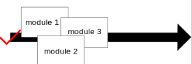
Different Module Format
Asynchronous Module Definition (AMD)
The AMD format is used in browsers
Using define function to define modules
AMD implementations load smaller JavaScript files, and then only when they are needed

Slide 14
AMD
The AMD format is used in browsers and uses a define function to define modules
AMD implementation allow developers to encapsulate code in smaller, more logically-organized files
//Calling define with a dependency array and a factory function define(['jquery', 'underscore', 'libs/utils'], function($, _, Utils) { //Define the module value by returning a value. var obj = { //... }; return obj; })

Slide 15
AMD (2)
AMD provides some CommonJS interoperability. It allows for using a similar exports and require()
Demo: https://repl.it/@vuilendi/amd-example
define(function(require, exports) { var mod = require('./app/module'); exports.value = module.getValue(); })

Slide 16
Different Module Format
CommonJS (CJS)
The CommonJS (CJS) format is used in Node.js
Using require and module.exports to define dependencies and modules
npm ecosystem is built upon this format

Slide 17
CJS
CommonJS was a project with the goal to establish conventions on module ecosystem for JavaScript outside of the web browser.
The CommonJS (CJS) format is used in Node.js and uses require and module.exports to define dependencies and modules
var dep1 = require('./dep1'); var dep2 = require('./dep2'); module.exports = function(){ // ... }

Slide 18
CJS (2)
CommonJS wraps each module in a function called `require`, and includes an object called `module.exports`
In circle.js
In circle_calculate.js
const PI = Math.PI; exports.area = (r) => PI * r *r; exports.circumference = (r) => 2 * PI * r;
const circle = require('./circle'); console.log(`The area of a circle of radius 4 is ${circle.area(4)}`); console.log(`The circumference of a circle of radius 4 is ${circle.circumference(4)}`);

Slide 19
Different Module Format
ES Module (ESM)
As of ES6 (ES2015), JavaScript supports a native module format.
Using export keyword to export a module’s public API
Using an import keyword to import it

Slide 20
ESM
ES Modules is the ECMAScript standard for working with modules.
This standardization process completed with ES6 and browsers started implementing this standard trying to keep everything well aligned, working all in the same way.
ES Modules are supported in Chrome, Safari, Edge and Firefox (since version 60)
Modules are very cool, because they let you encapsulate all sorts of functionality, and expose this functionality to other JavaScript files, as libraries

Slide 21
ESM: import module
Import a module:
Import with alias, using as
Or load an entire module at once
import package from 'module-name'
import { sayHello } from './lib'; sayHello(); // => Hello
import { sayHello as say } from './lib'; say(); // => Hello
import * as lib from './lib'; lib.sayHello(); // => Hello

Slide 22
ESM: exports
lib.js
Which you can import like this:
// Export default function export default function sayHello(){ console.log('Hello'); } // Export non-default function export function sayGoodbye(){ console.log('Goodbye'); }
import sayHello, { sayGoodbye } from './lib'; sayHello(); // => Hello sayGoodbye(); // => Goodbye

Slide 23
ESM: exports (2)
You can export not only functions, but anything you like:
// Export default function export default function sayHello(){ console.log('Hello'); } // Export non-default function export function sayGoodbye(){ console.log('Goodbye'); } // Export simple value export const apiUrl = '...'; // Export object export const settings = { debug: true }

Slide 24
Different Module Format
System.register
Designed to support ES6 modules within ES5
It is a format that was developed out of collaboration and is supported as a module output in Traceur (as instantiate), Babel, TypeScript and Rollup (as system)
Currently these include SystemJS, SystemJS Self-Executing Bundles and ES6 Micro Loader

Slide 25
System.register
ES6
Traceur output & Babel system output
import { p as q } from './dep'; var s = 'local'; export function func() { return q; } export class C { }
System.register(['./dep'], function($__export, $__moduleContext) { var s, C, q; function func() { return q; } $__export('func', func); return { setters: [ // every time a dependency updates an export, // this function is called to update the local binding // the setter array matches up with the dependency array above function(m) { q = m.p; } ], execute: function() { // use the export function to update the exports of this module s = 'local'; $__export('C', C = $traceurRuntime.createClass(...)); } }; });

Slide 26
Different Module Format
Universal Module Definition (UMD)
UMD format can be used both in the browser and in Node.js
It’s useful when a module needs to be imported by a few different module loaders.

Slide 27
UMD
The UMD (Universal Module Definition) pattern is used when our module needs to be imported by a number of different module loaders (e.g. AMD, CommonJS).
The pattern itself consists of two parts:
An IIFE that checks for the module loader that is being implemented by the user. This will take two arguments root ( a this reference to the global scope) and factory (the function where we declare our module).
An anonymous function that creates our module. This is passed as the second argument to the IIFE portion of the pattern. This function is passed any number of arguments to specify the dependencies of the module.

Slide 28
UMD (2)
In the below example we check for AMD, then CommonJS. If neither of those loaders are in use, we fall back to making the module and its dependencies available globally.
(function (root, factory) { if (typeof define === 'function' && define.amd) { // AMD. Register as an anonymous module. define(['exports', 'b'], factory); } else if (typeof exports === 'object' && typeof exports.nodeName !== 'string') { // CommonJS factory(exports, require('b')); } else { // Browser globals factory((root.commonJsStrict = {}), root.b); } }(this, function (exports, b) { //use b in some fashion. // attach properties to the exports object to define // the exported module properties. exports.action = function () {}; }));

Slide 29
Requiring a Module
Node.js comes with a set of built-in modules that we can use in our code without having to install them
We need to require the module using the require keyword and assign the result to a variable.
Note that in CommonJS, modules are loaded synchronously and processed in the order they occur
const fs = require('fs'); const folderPath = '.'; // /home/test/ fs.readdir(folderPath, (err, files) => { files.forEach(file => { console.log(file); }); });

Slide 30
Creating and Exporting a Module
Now let’s look at how to create our own module and export it for use elsewhere in our program
company.js
company_info.js
Run node company_info.js
const getName = () => { return 'NashTech'; }; exports.getName = getName;
const company = require('./company'); console.log(`Company name: ${company.getName()}`);

Slide 31
Exporting Multiple Methods and Values
Update company.js
Update company_info.js
const getName = () => { return 'NashTech'; }; const getLocation = () => { return '364 Cong Hoa, P13, Q. Tan Binh' } const about = 'Software Development & Outsourcing' exports.getName = getName; exports.getLocation = getLocation; exports.about = about;
const company = require('./company'); console.log(`Company: ${company.getName()} - ${company.about}, location: ${company.getLocation()}`);

Slide 32
Variations in syntax
it’s possible to export methods and values as you go, not just at the end of the file.
Update company.js
Create company_short_info.js
exports.getName = () => { return 'NashTech'; }; const getLocation = () => { return '364 Cong Hoa, P13, Q. Tan Binh' } exports.about = 'Software Development & Outsourcing' exports.getLocation = getLocation;
const { getName, about } = require('./company'); console.log(`Company: ${getName()} - ${about}`);

Slide 33
Exporting a Default Value
In the above example, we’re exporting functions and values individually.
When you have a module that exports just the one thing, it’s more common to use module.exports
Create company_class.js

Slide 34
Exporting a Default Value (2)
Create company_class.js
Create company_class_info.js
class Company { constructor(name, location, about) { this.name = name; this.location = location; this.about = about; } getCompanyStats() { return ` Company Name: ${this.name} About: ${this.about} Location: ${this.location} ` } } module.exports = Company
const Company = require('./company_class'); const ourCompany = new Company(); console.log(ourCompany.getCompanyStats());

Slide 35
What’s the difference between module.exports and exports
Create moduleExport.js
Create testModuleExport.js
exports is reference of modules.exports
module.exports = { getName: () => { return 'NashTech'; }, getLocation: () => { return '364 Cong Hoa, P13, Q. Tan Binh'; }, about: 'Software Development & Outsourcing' };
const { getName, getLocation, about } = require('./moduleExport'); console.log(`Company: ${getName()} - ${about}, location: ${getLocation()}`);

Slide 36
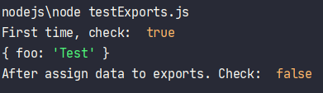
What’s the difference?
Create testExports.js
At the first time, we will get result = true.
After that we got false. So if we assign anything to module.exports, exports will not reference to module.exports.
exports.foo = 'Test' console.log('First time, check: ', exports===module.exports); console.log(module.exports); module.exports = {a: 'A'}; console.log('After assign data to exports. Check: ', exports===module.exports);

Slide 37
Forms, File Uploads and Security

Slide 38
Forms, File Uploads & Security
Focus Items
What do we want to build?
Displaying the Form
Form Submission
Validation and Sanitization
Security considerations
File Uploads

Slide 39
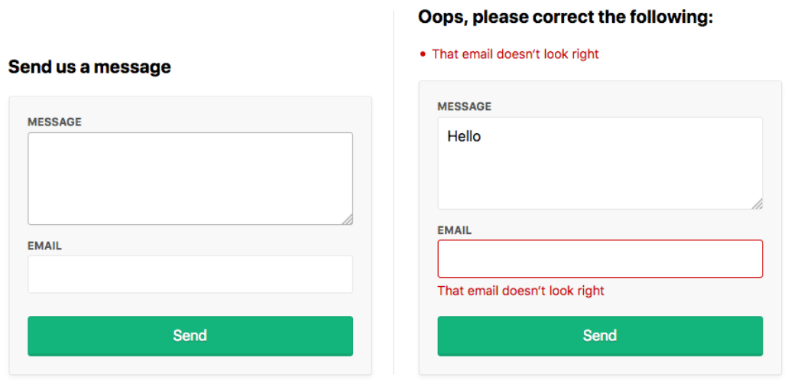
What do we want to build?
We will build form, that will send message and email to our server.
When user don’t input email or invalid email, we will display notice.

Slide 40
Setup
Make sure your Node.js version should >= 8.9.0
Create folder form-validate, use npm init to create package json like that:
{ "name": "form-validate", "version": "1.0.0", "description": "form validate with express", "main": "index.js", "scripts": { "test": "echo \"Error: no test specified\" && exit 1" }, "author": "", "license": "ISC" }

Slide 41
Setup (2)
We need to install some necessary packages
express: popular node.js framework
express-flash: Flash Messages for your Express Application
express-layout: Adds layout support to Express
express-session: Create a session middleware with the given options. (Session data is not saved in the cookie itself, just the sessionID. Session data is stored server-side)
express-validator: Express’s middleware that wraps validator.js validator and sanitizer functions.
helmet: helps ;you secure your Express apps by setting various HTTP headers.
multer: node.js middleware for handling multipart/form-data.

Slide 42
Setup (3)
We need to install some necessary packages
express: popular node.js framework
express-flash: Flash Messages for your Express Application
express-layout: Adds layout support to Express
express-session: Create a session middleware with the given options. (Session data is not saved in the cookie itself, just the sessionID. Session data is stored server-side)
express-validator: Express’s middleware that wraps validator.js validator and sanitizer functions.
helmet: helps ;you secure your Express apps by setting various HTTP headers.
multer: node.js middleware for handling multipart/form-data.

Slide 43
Setup (4)
cookie-parser: parse Cookie header and populate req.cookies with an object keyed by the cookie names.
csurf: A middleware for CSRF token creation and validation.
ejs: JavaScript template, complies with Express view system
body-parser: Node.js body parsing middleware
Run command line
Update package.json
npm i -s express express-flash express-layout express-session express-validator helmet multer cookie-parser csurf ejs body-parser
"scripts": { "test": "echo \"Error: no test specified\" && exit 1", "start": "nodemon index.js" },

Slide 44
index.js
Create index.js
Require all modules we need
Set views and view engine for app (create folder views)
Create middleware for app
const path = require('path') const express = require('express') const layout = require('express-layout') // Build routes for app const routes = require('./routes') // Start app with express framework const app = express()
// Set views as folder contain views app.set('views', path.join(__dirname, 'views')) // Using ejs as view engine app.set('view engine', 'ejs')
const middlewares = [ // Using layout of express layout layout(), // Set public as static folder express.static(path.join(__dirname, 'public')) ] app.use(middlewares)

Slide 45
index.js (2)
Set routes to apps
Set status 404 and 500 for app
Start app, listen port 3000 as default
// app use routes app.use('/', routes)
app.use((req, res, next) => { res.status(404).send("Sorry can't find that!") }) app.use((err, req, res, next) => { console.error(err.stack) res.status(500).send('Something broke!') })
// Start app, listen port 3000 as default app.listen(3000, () => { console.log(`App running at http://localhost:3000`) })

Slide 46
routes.js
Create routes.js to manage route of app
const express = require('express'); // Call express.Router const router = express.Router(); // With method 'get' and path '/' we will generate index view router.get('/', (req, res) => { res.render('index'); }); module.exports = router;

Slide 47
Layout, view of app
Create view for index (views/index.ejs)
Create layout for app (views/layout.ejs)
Create public/style.css
<h1>Create form validate with Express</h1>
<!DOCTYPE html> <html lang="en"> <head> <meta charset="UTF-8"> <title>Build form validation</title> <link rel="stylesheet" href="/style.css" type="text/css" /> </head> <body> <%- body %> </body> </html>

Slide 48
Create style
Create public/style.css
Download from gitlab material for reference.

Slide 49
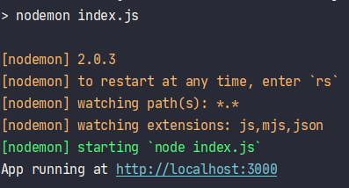
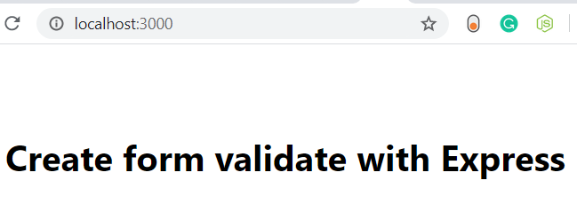
Run test
Run command line: npm start
Browse to http://localhost:300

Slide 50
Displaying the Form
When user make GET request to /contact, we will generate contact.ejs view: (update routes.js)
Create views/contact.ejs
// method 'GET' path '/contact' router.get('/contact', (req, res) => { res.render('contact'); });
<!-- views/contact.ejs --> <div class="form-header"> <h2>Send us a message</h2> </div> <form method="post" action="/contact" novalidate> <div class="form-field"> <label for="message">Message</label> <textarea class="input" id="message" name="message" rows="4" autofocus></textarea> </div> <div class="form-field"> <label for="email">Email</label> <input class="input" id="email" name="email" type="email" value="" /> </div> <div class="form-actions"> <button class="btn" type="submit">Send</button> </div> </form>

Slide 51
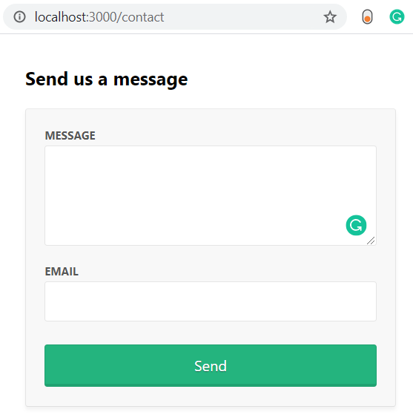
Displaying the Form (2)
Browse to http://localhost:3000/contact

Slide 52
Form Submission
To receive POST values in Express, We use body-parser
Update routes.js for POST contact
// index.js const bodyParser = require('body-parser'); const middlewares = [ // ... bodyParser.urlencoded({ extended: true }), ];
router.get('/contact', (req, res) => { res.render('contact', { data: {}, errors: {} }); }); router.post('/contact', (req, res) => { res.render('contact', { data: req.body, // { message, email } errors: { message: { msg: 'A message is required' }, email: { msg: 'That email doesn‘t look right' } } }); });

Slide 53
Form Submission (2)
If there are any validation errors, we’ll do the following:
display the errors at the top of the form
set the input values to what was submitted to the server
display inline errors below the inputs
add a form-field-invalid class to the fields with errors
<!-- views/contact.ejs --> <div class="form-header"> <% if (Object.keys(errors).length === 0) { %> <h2>Send us a message</h2> <% } else { %> <h2 class="errors-heading">Oops, please correct the following:</h2> <ul class="errors-list"> <% Object.values(errors).forEach(error => { %> <li><%= error.msg %></li> <% }) %> </ul> <% } %> </div>

Slide 54
Form Submission (3)
<form method="post" action="/contact" novalidate> <div class="form-field <%= errors.message ? 'form-field-invalid' : '' %>"> <label for="message">Message</label> <textarea class="input" id="message" name="message" rows="4" autofocus><%= data.message %></textarea> <% if (errors.message) { %> <div class="error"><%= errors.message.msg %></div> <% } %> </div> <div class="form-field <%= errors.email ? 'form-field-invalid' : '' %>"> <label for="email">Email</label> <input class="input" id="email" name="email" type="email" value="<%= data.email %>" /> <% if (errors.email) { %> <div class="error"><%= errors.email.msg %></div> <% } %> </div> <div class="form-actions"> <button class="btn" type="submit">Send</button> </div> </form>

Slide 55
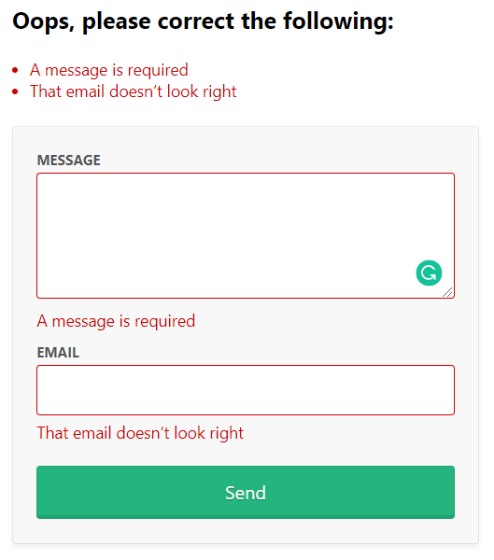
Form Submission (4)
Browse to http://localhost:3000/contact
Click Send.

Slide 56
Validation and Sanitization
We will use express-validator for validating and sanitization.
Validation:
With validators provided, we can easily check that a message and a valid email address was provided:
const { check, validationResult, matchedData } = require('express-validator'); router.post('/contact', [ check('message') .isLength({ min: 1 }) .withMessage('Message is required'), check('email') .isEmail() .withMessage('That email doesn‘t look right') ], (req, res) => { const errors = validationResult(req); res.render('contact', { data: req.body, errors: errors.mapped() }); });

Slide 57
Validation and Sanitization (2)
Sanitization:
With the sanitizers provided, we can trim whitespace from the start and end of the values and normalize the email address into a consistent pattern.
This can help remove duplicate contacts being created by slightly different inputs. For example, ' Mark@gmail.com' and 'mark@gmail.com ' would both be sanitized into 'mark@gmail.com'.

Slide 58
Validation and Sanitization (3)
// routes.js router.post('/contact', [ check('message') .trim() .isLength({ min: 1 }) .withMessage('Message is required'), check('email') .trim() .isEmail() .withMessage('That email doesn‘t look right') .bail() .normalizeEmail() ], (req, res) => { const errors = validationResult(req); res.render('contact', { data: req.body, errors: errors.mapped() }); // The matchedData function returns the output of the sanitizers on our input const data = matchedData(req); console.log('Sanitized:', data); });

Slide 59
Validation and Sanitization (4)
The matchedData function returns the output of the sanitizers on our input.
Also, notice our use of the bail method, which stops running validations if any of the previous ones have failed.
We need this because if a user submits the form without entering a value into the email field, the normalizeEmail will attempt to normalize an empty string and convert it to an @
This will then be inserted into our email field when we re-render the form.

Slide 60
The Valid Form
If there are errors, we need to re-render the view
If not, we need to do something useful with the data and then show that the submission was successful
Typically, the person is redirected to a success page and shown a message.
HTTP is stateless, so you can’t redirect to another page and pass messages along without the help of a session cookie to persist that message between HTTP requests.
A “flash message” is the name given to this kind of one-time-only message we want to persist across a redirect and then disappear

Slide 61
The Valid Form (2)
We will use three middlewares
The express-flash middleware adds req.flash(type, message), which we can use in our route handlers
// index.js const cookieParser = require('cookie-parser'); const session = require('express-session'); const flash = require('express-flash'); const middlewares = [ // ... cookieParser(), session({ secret: 'super-secret-key', key: 'super-secret-cookie', resave: false, saveUninitialized: false, cookie: { maxAge: 60000 } }), flash(), ];

Slide 62
The Valid Form (3)
Update routes.js
// routes.js router.post('/contact', [ check('message') .trim() .isLength({ min: 1 }) .withMessage('Message is required'), check('email') .trim() .isEmail() .withMessage('That email doesn‘t look right') .bail() .normalizeEmail() ], (req, res) => { const errors = validationResult(req); if (!errors.isEmpty()) { return res.render('contact', { data: req.body, errors: errors.mapped() }); } const data = matchedData(req); console.log('Sanitized: ', data); req.flash('success', 'Thanks for the message! I‘ll be in touch :)'); res.redirect('/'); });

Slide 63
The Valid Form (4)
The express-flash middleware adds messages to req.locals which all views have access to
<!-- views/index.ejs --> <% if (messages.success) { %> <div class="flash flash-success"><%= messages.success %></div> <% } %> <h1>Create form validate with Express</h1>

Slide 64
Security considerations
The best security advice: “Never trust the client!”
TLS over HTTPS: Always use TLS encryption over https:// when working with forms so that the submitted data is encrypted when it’s sent across the Internet
Wear your Helmet: There’s a neat little middleware called helmet that adds some security from HTTP headers. It’s best to include right at the top of your middlewares and is super easy to include
Cross-site request forgery (CSRF)
Cross-site scripting (XSS)
// index.js const helmet = require('helmet'); middlewares = [ helmet(), // ... ];

Slide 65
Security considerations (2)
Cross-site request forgery (CSRF): Generating a unique token when the user is presented, validating that token before the POST data is processed
In the GET request, we generate a token:
// routes.js const csrf = require('csurf'); const csrfProtection = csrf({ cookie: true });
router.get('/contact', csrfProtection, (req, res) => { res.render('contact', { data: {}, errors: {}, csrfToken: req.csrfToken() }); });

Slide 66
Security considerations (3)
And in the validation error response:
Then we just need include the token in a hidden input
router.post('/contact', csrfProtection, [ // validations ... ], (req, res) => { const errors = validationResult(req); if (!errors.isEmpty()) { return res.render('contact', { data: req.body, errors: errors.mapped(), csrfToken: req.csrfToken() }); } // ... });
<!-- view/contact.ejs --> <form method="post" action="/contact" novalidate> <input type="hidden" name="_csrf" value="<%= csrfToken %>"> <!-- ... --> </form>

Slide 67
Security considerations (4)
Cross-site scripting (XSS):
You need to take care when displaying user-submitted data in an HTML view as it can open you up to cross-site scripting(XSS)
The EJS <%= value %> outputs the HTML escaped value to protect you from XSS, whereas <%- value %> outputs a raw string.
Always use the escaped output <%= value %> when dealing with user-submitted values. Only use raw outputs when you’re sure that it’s safe to do so.

Slide 68
File Uploads
Uploading files in HTML forms is a special case that requires an encoding type of "multipart/form-data“
You’ll need additional middleware to handle multipart uploads
This code instructs multer to upload the file in “photo” field
// routes.js const multer = require('multer'); const upload = multer({ storage: multer.memoryStorage() }); router.post('/contact', upload.single('photo'), csrfProtection, [ // validation ... ], (req, res) => { // error handling ... if (req.file) { console.log('Uploaded: ', req.file); } req.flash('success', 'Thanks for the message! I’ll be in touch :)'); res.redirect('/'); });

Slide 69
File Uploads (2)
Uploading files in HTML forms is a special case that requires an encoding type of "multipart/form-data“
You’ll need additional middleware to handle multipart uploads
// routes.js const multer = require('multer'); const storage = multer.diskStorage( { destination: 'public/uploads/', filename: function ( req, file, cb ) { const arrFile = file.originalname.split("."); const ext = arrFile[1]; const fileName = arrFile[0]; cb(null, `${fileName}-${Date.now()}.${ext}`); } } ); const upload = multer({ storage: storage });
router.post('/contact', upload.single('photo'), csrfProtection, [ // validation ... ], (req, res) => { // error handling ... if (req.file) { console.log('Uploaded: ', req.file); } req.flash('success', 'Thanks for the message! I’ll be in touch :)'); res.redirect('/'); });

Slide 70
File Uploads (3)
This code instructs multer to upload the file in “photo” field
We need to update contact.ejs, add enctype attribute to form and add photo field
<form method="post" action="/contact" novalidate enctype="multipart/form-data"> <input type="hidden" name="_csrf" value="<%= csrfToken %>"> <div class="form-field <%= errors.message ? 'form-field-invalid' : '' %>"> <label for="message">Message</label> <textarea class="input" id="message" name="message" rows="4" autofocus><%= data.message %></textarea> <% if (errors.message) { %> <div class="error"><%= errors.message.msg %></div> <% } %> </div> <div class="form-field <%= errors.email ? 'form-field-invalid' : '' %>"> <label for="email">Email</label> <input class="input" id="email" name="email" type="email" value="<%= data.email %>" /> <% if (errors.email) { %> <div class="error"><%= errors.email.msg %></div> <% } %> </div> <div class="form-field"> <label for="photo">Photo</label> <input class="input" id="photo" name="photo" type="file" /> </div> <div class="form-actions"> <button class="btn" type="submit">Send</button> </div> </form>

Slide 71
Q&A

